Slide 1
JOBFINDER: A PERSONALIZED RÉSUMÉ – JOB MATCHINGSYSTEM
MS Thesis Presentation of:
Shiquang Guo
Sketch Recognition Lab
Department of Computer Science, TAMU
Dr. Tracy Hammond (Advisor)
Dr. Yoonsuck Choi (Member)
Dr. Daniel Goldberg (Member)

Slide 2





Motivation
Job finding websites are one of main channels today.
There are many job finding websites today.

Slide 3


They All Use Keyword Searching

Slide 4

Problems of Keyword Searching

Slide 5
Résumés as Query
The résumé has the most personal information
Education Background
Work experiences
Skills
Using the résumé as a query to search jobs
Ranking the jobs by their similarity scores

Slide 6
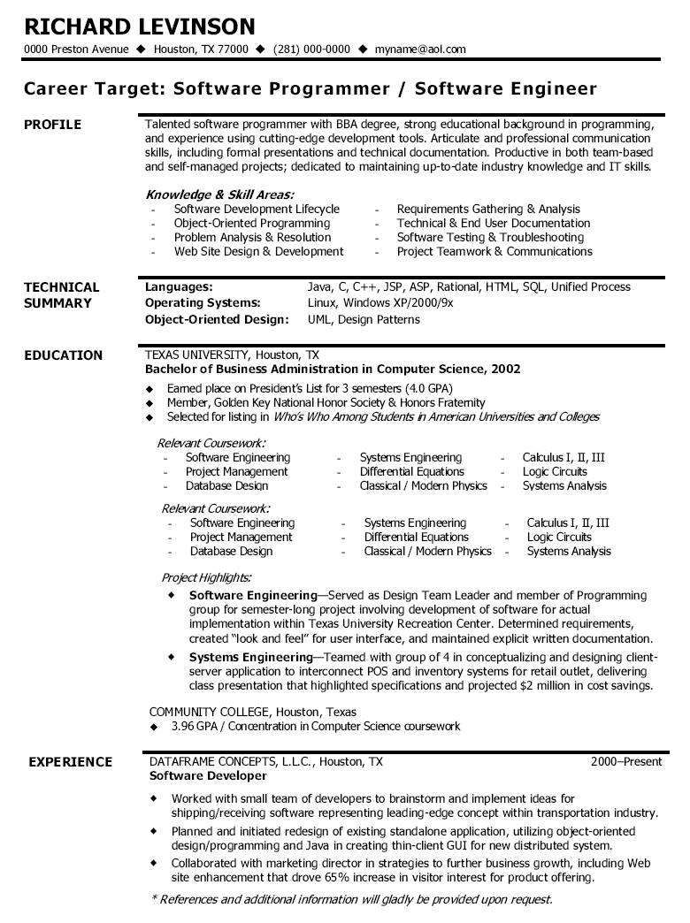
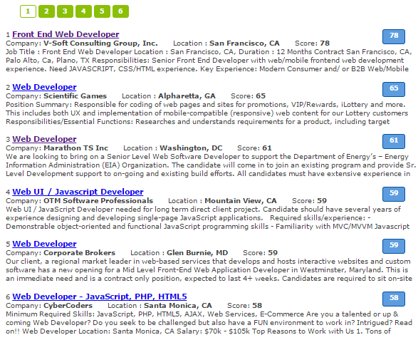
Job Finder

Slide 7
Contributions of our works
A résumé – job matching system
Propose a finite state transducer based tool for information extraction
Propose a semi-automatic approach to collect technical terms
Propose a statistical-based ontology similarity measure

Slide 8
Previous Work

Slide 9
Recommender Systems
Content-based Recommendation (CBR)
Suggesting items that have similar content information to the corresponding users.
Collaborative Filtering Recommendation (CFR).
Finding similar users who have the same taste with the target user and recommends items based on what the similar users.
Knowledge-based Recommendation (KBR)
Rules and patterns obtained from the functional knowledge of how a specific item meets the requirement of a particular use.
Hybrid Recommendation
Combines multiple recommendation techniques together to produce its output.
Notes:
Hybrid Recommendation : combines multiple recommendation techniques together to produce its output.

Slide 10
CASPER
CASPER (Rafter, Rachael, and Barry Smyth 2001)
Collaborative Filtering based Job Recommender System
Get User’s profile from server-log:
Jobs visited
Read time
Jobs Applied

Slide 11
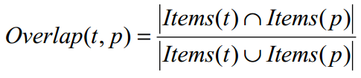

CASPER
Shortcomings of Collaborative Filtering
Cold start: new jobs have no review logs
Sparseness: few overlap in users’ profiles

Slide 12
Hybrid Recommender System
A recommender system for job seeking and recruiting website (Lu, Yao, Sandy El Helou, and Denis Gillet 2013)
Content – based Recommendation
Similarity is computed using Latent Semantic Analysis (LSA)
Collaborative Filtering Recommendation

Slide 13
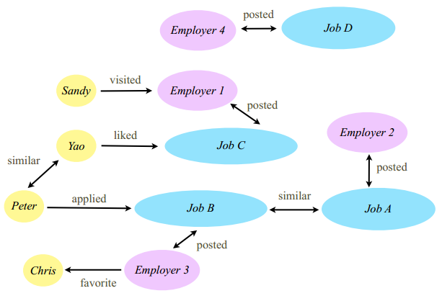
Hybrid Recommender System

Slide 14
IBM PROSPECT
Prospect (Singh, Amit, et al 2010)
A system that aids in the shortlisting of candidates for jobs.
Using Conditional Random Fields (CRFs) model to extract the information from résumés
Filtering the candidates with criteria

Slide 15
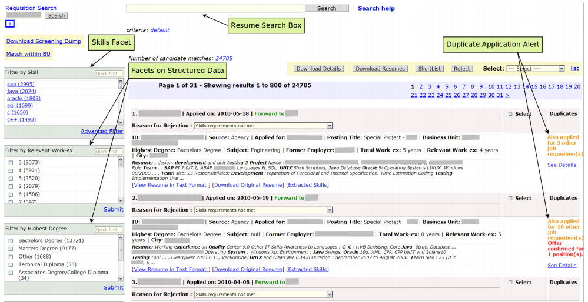
PROSPECT

Slide 16
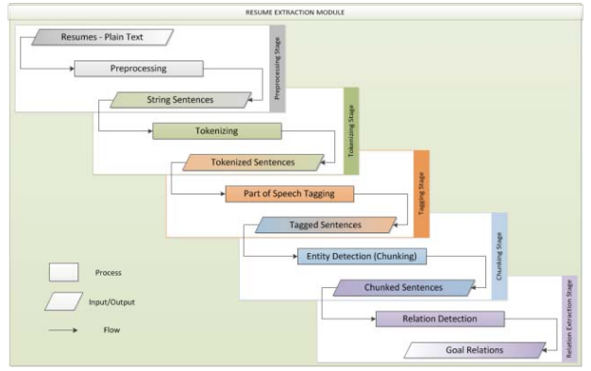
HP Resource Planning Tool
Adaptive employee profile classification for resource planning tool （ Gonzalez, Tere, et al. 2012）
Help managers to
find right candidates
Staged Information
Extraction Framework

Slide 17
Problems in Previous Work
Most systems can only process the structured data or synthetic data
The systems that have information extraction module are designed for recruiters
Information fields for matching résumés and job descriptions are coarse-grained.

Slide 18
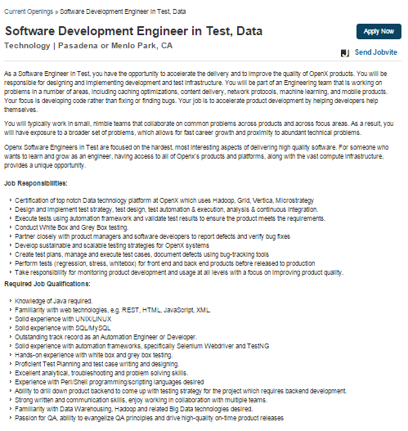
Problem Definition

Slide 19
Problem Definition
Calculating the similarity values between the user’s résumé and the job models.
Return the jobs ranked by their similarity values

Slide 20
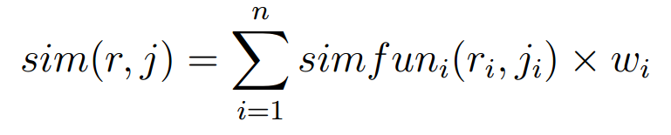
Model Similarity
r is the user‘s résumé model
r_{i} is the ith feature of résumé r
j is the job description model
j_{i} is the ith feature of job j
Similarity value is the summation of weighted similarity values of each field in the models

Slide 21
Challenges
How to extract models from unstructured data sources.
How to compute the similarity between résumé and job models.

Slide 22
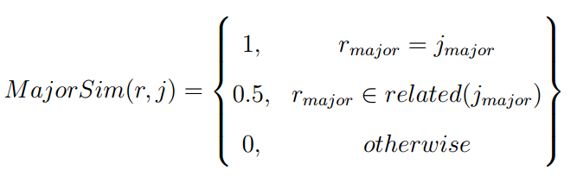
Model Similarity- Major

Slide 23
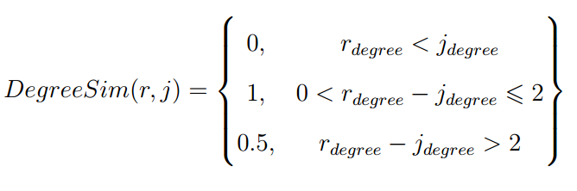
Model Similarity- Degree
High School | Associate | Bachelor | Master | Ph.D.
1 | 2 | 3 | 4 | 5

Slide 24
Model Similarity- Job Title
Job Role (Developer, Manager, Administrator)
Job Level (Junior, Senior and Architect)
Platform (Database, J2EE, Web )
Programming language (Python, Java, C++)
Summation of similarity all the fields between job and résumé
Several job titles in the résumé, return the one with maximum similarity value

Slide 25
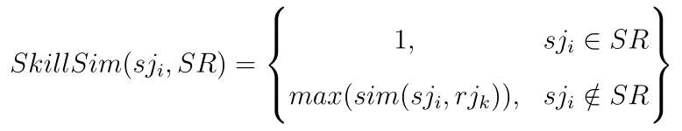

Model Similarity- Skills
is the ith skill in the job model
SR is the skill set of the résumé model
If in the skill set SR, return 1.
Otherwise return the maximum similarity value.

Slide 26
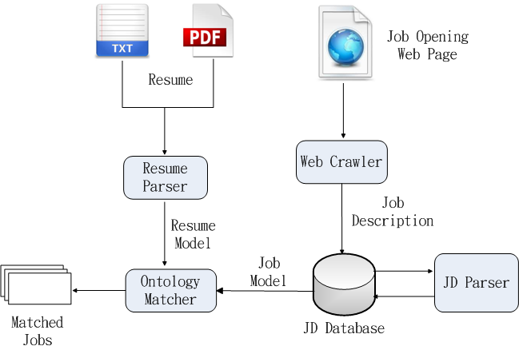
System Architecture

Slide 27
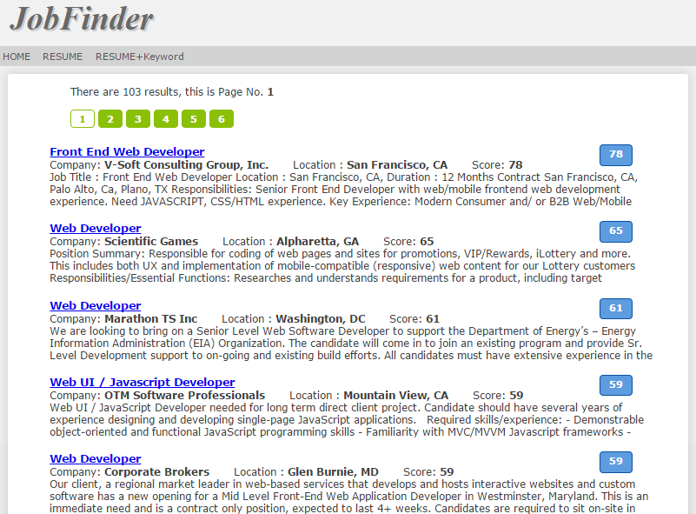
System Interface

Slide 28
Information Extraction

Slide 29
HCI Consideration
Users don’t like input their personal information
Recruiters don’t like to input job descriptions in forms
So we need extract information from the unstructured text data source.

Slide 30
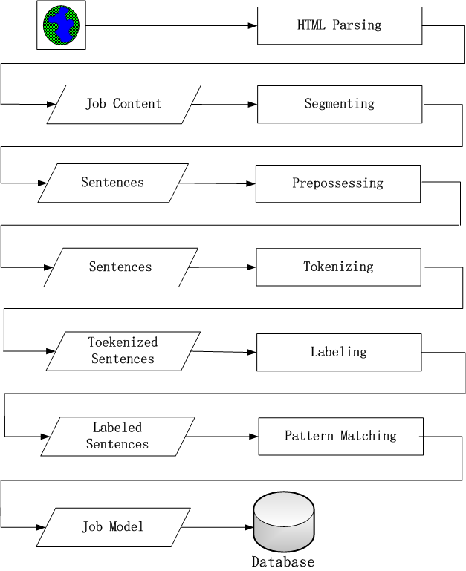
Information Extraction Stages
HTML Parsing
Segmenting
Preprocessing
Tokenizing
Labeling
Pattern Matching
Notes:
Acronym

Slide 31
Sentences of Degree Information
Bachelors degree in Computer or Information Systems
BS or MS in computer science or similar degree
MS/PhD Degree in Computer, Science, Engineering or Finance from top institution.
Requires a minimum of bachelors degree in a related, field or foreign equivalent.

Slide 32
Combinatorial Explosion
A single concept may have multiple expressions. For example, some words mean bachelors are:
Baccalaureate, bachelors, bachelor, B.S., BS, BA, BA/BS, 4-year, 4-year, 4 year, four year, college, Undergraduate , University
“bachelor’s degree”, the pattern will like below:
( Baccalaureate | bachelors | bachelor | B.S | BS | BA ) degree

Slide 33
Semantic Labeling
Original text | Layer 1 | Layer 2
bachelors | BS_LEVEL | DE_LEVEL
bachelor
B.S.
Baccalaureate
Master | MS_LEVEL
MS
M.S.
PhD | PHD_LEVEL
Ph.D
Doctorate
Notes:
Underline or undersore??

Slide 34
Semantic Labeling
Bachelors degree in computer science or information systems
To
DE_LEVEL | DEGREE | IN | MAJOR | OR | MAJOR | .
BS_LEVEL | DEGREE | IN | MAJOR_CS | OR | MAJOR_INFO | .
bachelors | degree | in | Computer Science | or | Information Systems | .

Slide 35
Token Pattern Matching Library
The unit of the regular expression is token or word
seqMatcher = parser.parse
( “ DE_LEVEL (, DE_LEVEL)* (or DE_LEVEL)? DEGREE”)

Slide 36
Pattern Matching
DE_LEVEL DEGREE IN MAJOR (OR MAJOR) ?
DE_LEVEL | DEGREE | IN | MAJOR | OR | MAJOR | .
BS_LEVEL | DEGREE | IN | MAJOR_CS | OR | MAJOR_INFO | .
bachelors | degree | in | Computer Science | or | Information Systems | .

Slide 37
Patterns for Matching Degrees
DE-LEVEL, DE-LEVEL, OR DE-LEVEL
DE-LEVEL DEGREE ( IN | OF ) DT MAJOR
MAJOR-DEGREE , MAJOR-DEGREE OR MAJOR
DE-LEVEL (, DE-LEVEL)* (OR DE-LEVEL)? BE? PERFER-VBD
MAJOR DEGREE
DE_LEVEL , OR DEGREE_JJ

Slide 38
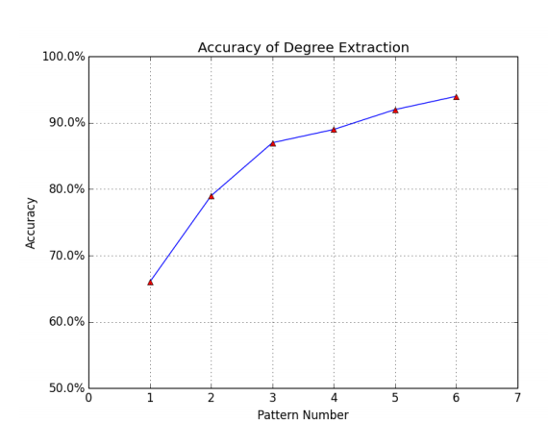
Accuracy Increases Monotonous

Slide 39
Implementation of Token Pattern Matching Library

Slide 40
Matchers current support
Matcher Name | Function | Counter Part of regex
UnitMatcher | Token to be matched | Character in regex
SequenceMatcher | A list of Matchers | Sequence of characters
QuestionMatcher | One or more of the preceding token | ?
StarMatcher | Zero or more of the preceding token | *
PlusMatcher | Zero or one of the preceding token | +
DotMatcher | Any token | .
RegexMatcher | Any token matches the regular expression | N/A

Slide 41
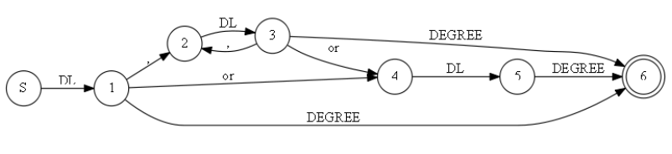
Finite Automata Transducer
A finite state transducer (FST) is a finite state machine with two tapes: an input tape and an output tape.

Slide 42
Flexibility–Regular Expression Style
Pattern: DE-LEVEL DEGREE ( IN | OF ) DT? MAJOR
seqMatcher =parser.parse(”DE-LEVEL DEGREE ( IN | OF ) DT? MAJOR”)

Slide 43
Connected by Algebra Operators
Pattern: ”DE-LEVEL DEGREE (IN | OF) MAJOR”
seqMatcher = UnitMatcher(”DE-LEVEL”) + UnitMatcher(”DEGREE”) + ( UnitMatcher(”IN”) | UnitMatcher(”OF” ) ) + UnitMatcher(”MAJOR”)

Slide 44
OO Programming Style
Pattern: ”DE-LEVEL DEGREE (IN | OF) MAJOR”
matcher1 = UnitMatcher(”DE-LEVEL”)
matcher2 = UnitMatcher(”DEGREE”)
matcher3 = UnitMatcher(”IN”)
matcher4 = UnitMatcher(”OF”)
matcher5 = UnitMatcher(”MAJOR”)
matcher6 = AlternateMatcher([matcher3,matcher4])
seqMatcher = SeqMatcher([matcher1, matcher2, matcher6, matcher5])

Slide 45
Simplicity
Easy to implement
The accuracy increases as the number of patterns increases
Faster
Time Complexity O(n)
Conditional Random Fields(CRFs), using Viterbi algorithm O(n²t)
Notes:
n state space, t length of the sequence

Slide 46
Ontology Similarity

Slide 47
Résumé and Job Description
Portion of a résumé | Portion of a job description
B.S. degree in computer science 5+ years Java 2+ year C++ Some experience in Oracle database Other experience like: Hibernate, JBOSS, JUnit, Tomcat etc. | BS degree above 4+ years Java Some experience of Python Mysql, MS-SQL Java web application Server OOA/OOD

Slide 48
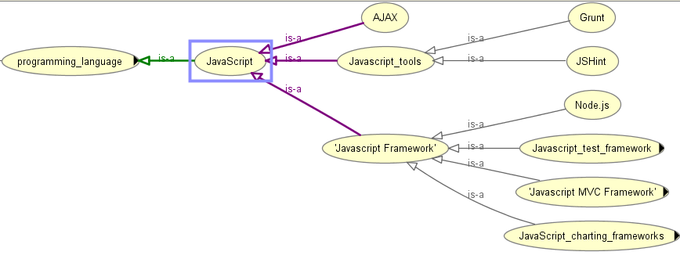
Ontology

Slide 49
Statistical-based Measure
A high-level language such as Java, Groovy, Ruby or Python; we use Java and Groovy extensively
HTML5/CSS3/JavaScript, web standards, jQuery or frameworks like AngularJS would be great
HTML CSS and Javascript a must 4. Experience with AJAX, XML, XSL, XSLT, CSS, JavaScript, JQuery, HTML and Web Services

Slide 50
Statistical-based Measure
Related skills always exist in the job description simultaneously.
The smaller the distance of two skills, the closer the relationship between them.

Slide 51
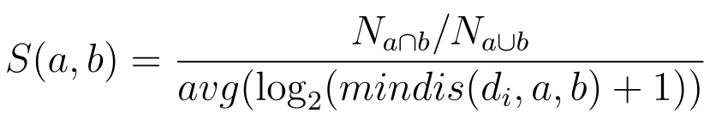



Statistical-based Measure
The number of documents in which the two terms exist together .
The number of documents that have at least one them.
The log value of minimum distance of the two terms in the documents that have them both.
Notes:
logarithmic

Slide 52
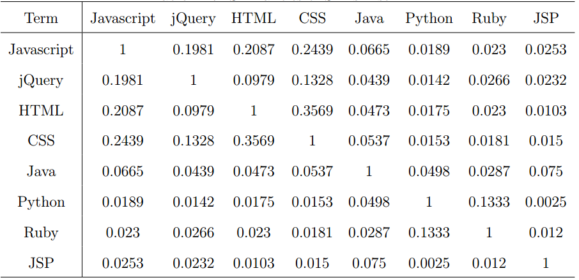
Similarity Values between Skills

Slide 53
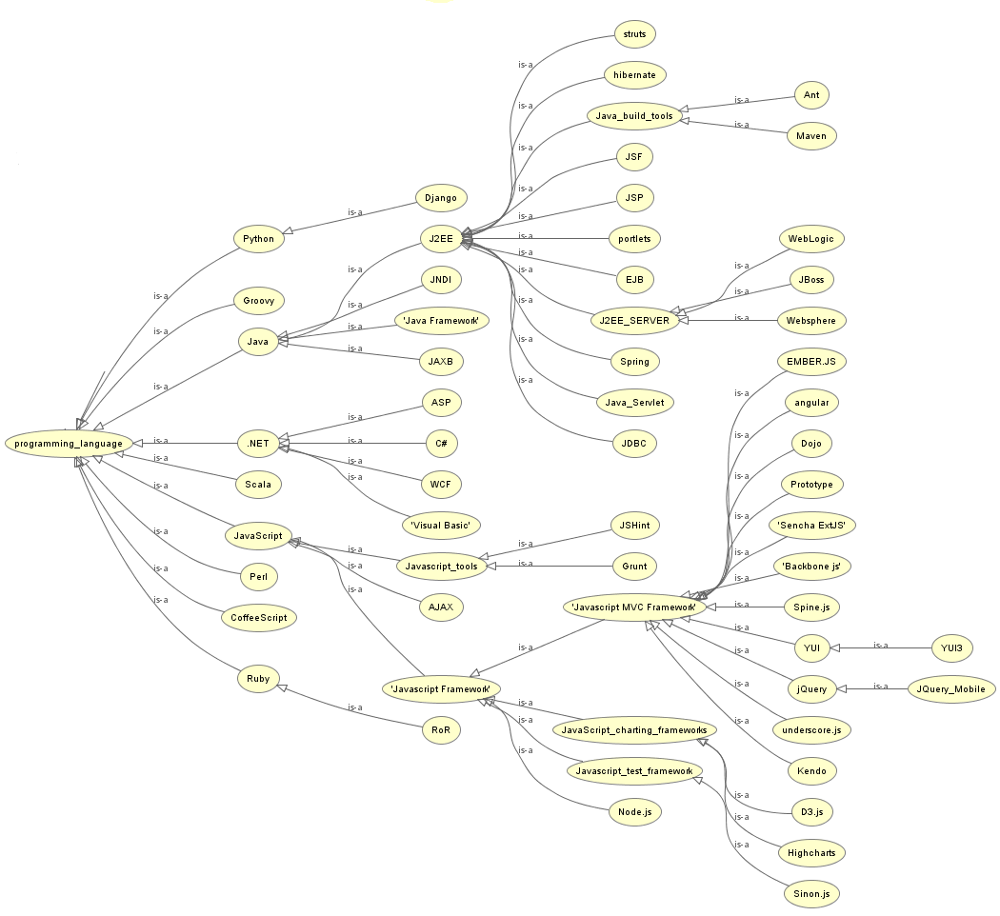

Slide 54
Ontology Construction

Slide 55
Find Terms in Job Descriptions
A high-level language such as Java, Groovy, Ruby or Python; we use Java and Groovy extensively
HTML5/CSS3/JavaScript, web standards, jQuery or frameworks like AngularJS would be great
HTML CSS and Javascript a must 4. Experience with AJAX, XML, XSL, XSLT, CSS, JavaScript, JQuery, HTML and Web Services

Slide 56
Bootstrap Approach
Pattern to extract terms
TERM , * , *, (AND)? TERM
Bootstrap approach
Collecting fifty initial terms manually, and adding them to term list
Using the pattern matching library to find new terms
Checking the found terms on Dbpedia
under the technical categories like software, programming language and so on.
Adding the new terms in to term list

Slide 57
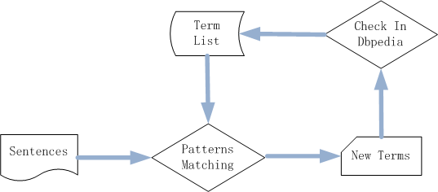
Bootstrap Approach

Slide 58

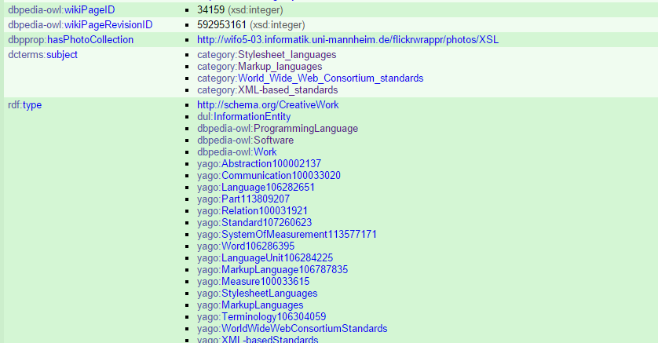
Dbpedia Page

Slide 59
EVALUATION

Slide 60
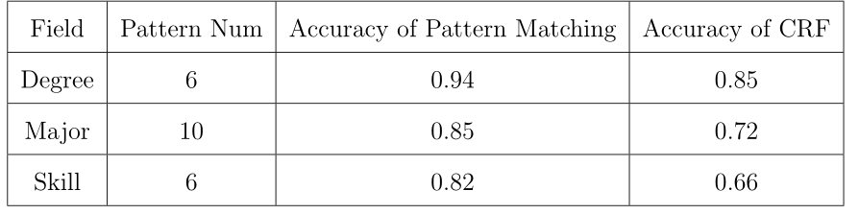
Information Extraction
Accuracy of Information Extraction Comparing to CRFs Model

Slide 61



Ontology Similarity
let be the relevance score assessors gave to document for query
NDCG – Normalized Discounted Cumulative Gain
rel_{i} is the relevance score assessors given to document d for query j
Notes:
the graded relevance value is reduced logarithmically proportional to the position of the result.

Slide 62
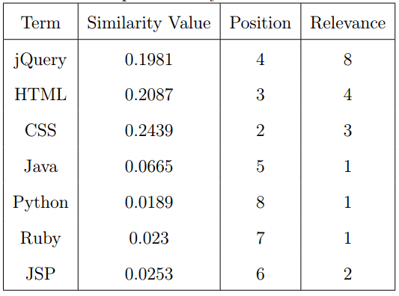
Ontology Similarity
Terms similarity for Javascript, NDCG = 0.94

Slide 63
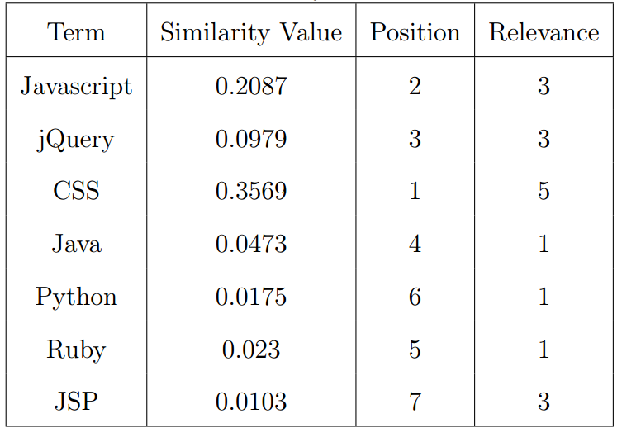
Ontology Similarity
Terms similarity for HTML, NDCG = 0.94

Slide 64
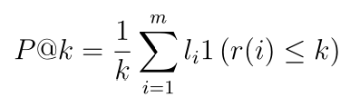
Résumé – Job Matching
NDCG
Precision@K
The proportion of relevant documents in the first K results

Slide 65
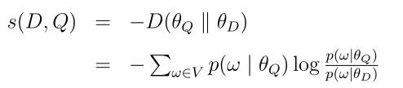
Models to be Compared With
KL： Kullback-Leibler divergence
A non-symmetric measure of the difference between two probability distributions of P and Q.
Notes:
In words, it is the expectation of the logarithmic difference between the probabilities P and Q, where the expectation is taken using the probabilities P.

Slide 66

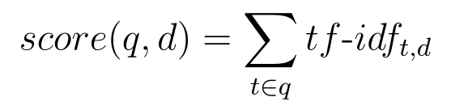
Models to be Compared With
TF-IDF：A weighting factor in information retrieval and text mining
TF: The term frequency
IDF: The inverse document frequency
Notes:
numerical statistic that is intended to reflect how important a word is to a document in a collection or corpus。

Slide 67
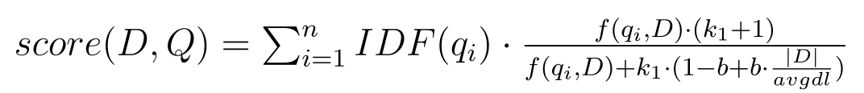
Models to be Compared With
Okapi BM25:
A bag-of-words retrieval model that ranks a set of documents based on the query terms appearing in each document
Notes:
Where f(q,D) is 's term frequency in the document D

Slide 68
Experiment Setup
5 résumés
100 jobs in the system
Relevance values between résumés and jobs are manually assigned

Slide 69
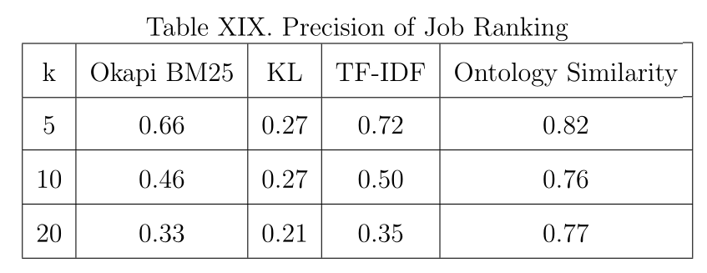
Ontology Matching
Precision@k of Resume-Job Matching

Slide 70
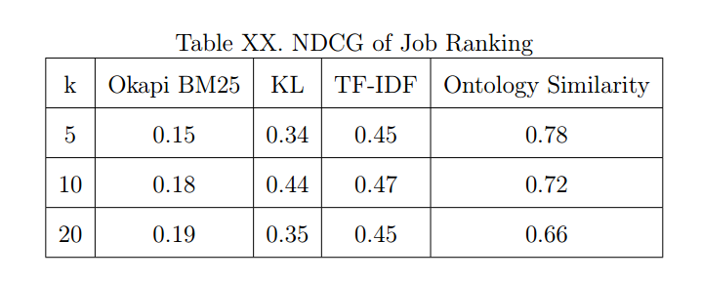
Ontology Matching
NDCG of Resume-Job Matching

Slide 71
Comparing with Indeed.com
Keyword search in Indeed
Collecting the front 100 search results
Relevance values between résumés and jobs are manually assigned
Using our system to re-rank the results

Slide 72
Comparing with Indeed.com
Searching Keyword: Java
K | Precision@k |  | DCG
 | Indeed | Ontology Matching | Indeed | Ontology Matching
5 | 0.6 | 1 | 13.35 | 24.39
10 | 0.5 | 0.9 | 17.8 | 27.64
20 | 0.5 | 0.7 | 25.62 | 41.67

Slide 73
Comparing with Indeed.com
Searching Keyword: Python
K | Precision@k |  | DCG
 | Indeed | Ontology Matching | Indeed | Ontology Matching
5 | 0.4 | 0.6 | 11.27 | 11.98
10 | 0.3 | 0.6 | 13.43 | 15.79
20 | 0.2 | 0.4 | 16.44 | 20.21

Slide 74
Comparing with Indeed.com
5 keywords
5 résumés
K | Precision@k |  | DCG
 | Indeed | Ontology Matching | Indeed | Ontology Matching
5 | 0.67 | 0.82 | 13.15 | 16.63
10 | 0.53 | 0.81 | 16.96 | 21.03
20 | 0.41 | 0.63 | 21.90 | 30.02

Slide 75
Summary
A résumé – job matching system
A finite state transducer based pattern matching tool for information extraction
A semi-automatic approach to collect technical terms
A statistical-based ontology similarity measure

Slide 76
Future Work
Clustering the résumé and job models to decrease the size of the matching set.
Building more complex job and résumé model
Using hybrid recommendation techniques

Slide 77
Acknowledgements
Dr. Tracy Hammond (Chair)
Dr. Anxiao Jiang (Committee member)
Dr. Daniel W. Goldberg (Committee member)
Members of Sketch Recognition Lab

Slide 78
Reference
ACM. (2012) Acm computing classication system. [Online]. Available: http://www.acm.org/about/class/2012
A. V. Aho and J. D. Ullman, Foundations of computer science. Computer Science Press New York, 1992, vol. 2.
S. T. Al-Otaibi and M. Ykhlef, \A survey of job recommender systems," International Journal of the Physical Sciences, vol. 7, no. 29, pp. 5127{5142, 2012.
D. E. Appelt and B. Onyshkevych, \The common pattern specication language," in Proceedings of a workshop on held at Baltimore, Maryland: October 13-15, 1998. Association for Computational Linguistics, 1998, pp. 23{30.
S. Bird, \Nltk: the natural language toolkit," in Proceedings of the COLING/ACL on Interactive presentation sessions. Association for Computational Linguistics, 2006, pp. 69 - 72.
C. Bizer, J. Lehmann, G. Kobilarov, S. Auer, C. Becker, R. Cyganiak, and S. Hellmann, \Dbpedia-a crystallization point for the web of data," Web Semantics: science, services and agents on the world wide web, vol. 7, no. 3, pp.154-165, 2009.

Slide 79
Thank you

Slide 80

Models to be Compared With
Evaluation
KL： Kullback-Leibler divergence (C. Zhai, 2008)
KL is a measure of the information lost when Q is used to approximate P.
P(i) : Probability of word i in document P.
Q(i) : Probability of word i in document P.
Notes:
In words, it is the expectation of the logarithmic difference between the probabilities P and Q, where the expectation is taken using the probabilities P.

